Slide 1
Umbrella Sampling, Thermodynamic Integration, Replica Exchange Molecular dynamics, and Metadynamics
Instructor: Prof. Tzuhsiung (Nick) Yang
Email: tyang@mx.nthu.edu.tw
Time: M5/6
Room: NTHU Library Comp Lab II
Notes:
Rafael Gomez

Slide 2
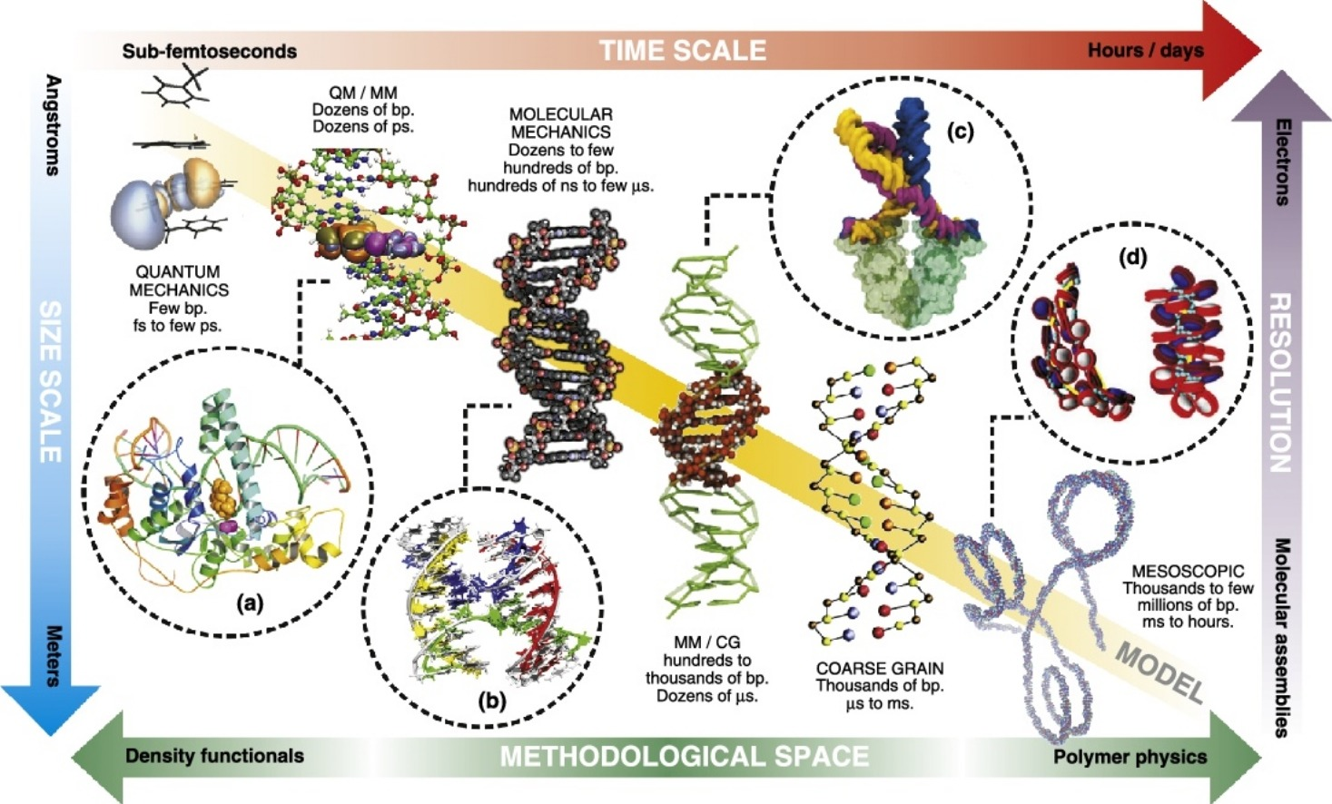
Multiscale simulation
Dans, P. D.; Walther, J.; Gómez, H.; Orozco, M. Multiscale Simulation of DNA. Current Opinion in Structural Biology 2016, 37, 29-45.

Slide 3
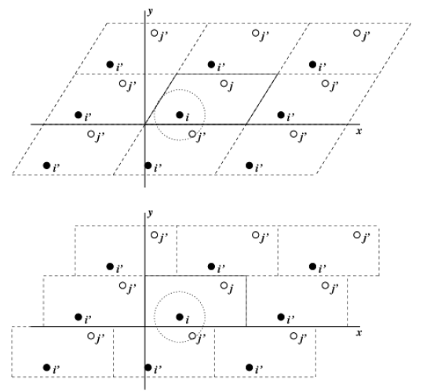
Refining the System
The Streptavidin-Biotin were built in the previous class. But if we look closely, the complex may appear "broken" or may "jump" back and forth across the box. This is because the periodic boundary condition of the box (pbc box). To refine our system, the gromacs trajconv command is applied.

Slide 4
Interactive
Login to ${USER}@ln01.twnia2.twcc.aii
Go to Week10/Exercise2
gmx trjconv -s md_0_10.tpr -f md_0_10.xtc -center -pbc mol -ur compact -o md_0_10_center.xtc
1
0
gmx trjconv -s md_0_10.tpr -f md_0_10_center.xtc -fit rot+trans -o md_0_10_center_fit.xtc
4
0
gmx trjconv -s md_0_10.tpr -f md_0_10_center.xtc -dump 0 -o md_0_10_center_start.pdb
0

Slide 5
Interactive
Now load the movie using md_0_10_center_start.pdb as your first frame and md_0_10_center_fit as the trajectory.

Slide 6
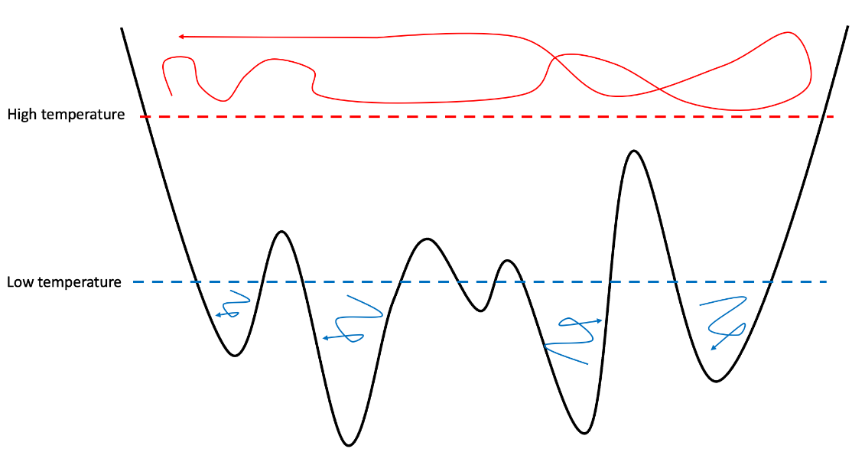
Sampling the PES
But really, what we are interested is the rare events, such as the dissociation of the ligand out of the protein and the associated free energy change.
One straightforward method is to run a longer MD simulation. However, if 1ms MD takes a day, 1s will take 1,000,000 days to run, which is longer than your life time.
Current temperatures
Local minimums

Slide 7
Enhanced sampling
There are multiple ways we can accelerate the sampling of these rare events:
1. Umbrella sampling (the MD equivalent of relaxed surface scan)

Slide 8
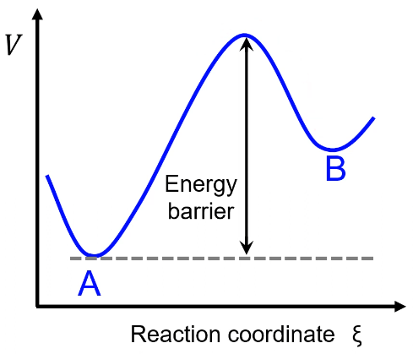

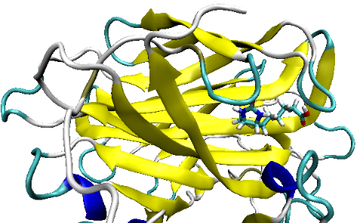
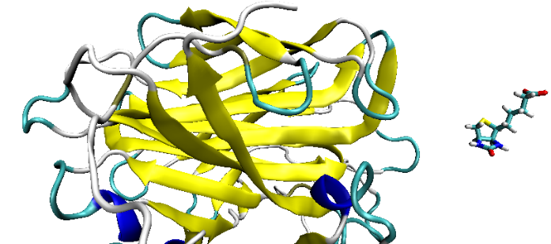
The Umbrella Sampling
There is a process in a certain reaction coordinate with a high energy barrier.
How we define the reaction coordinate?

Slide 9
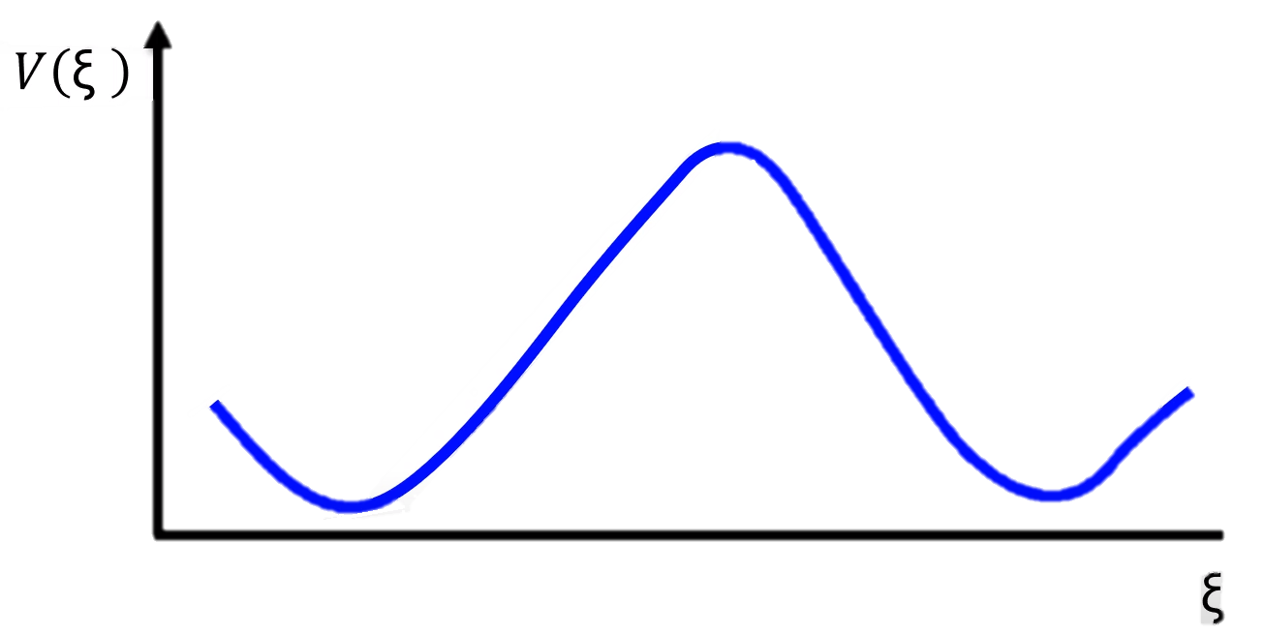
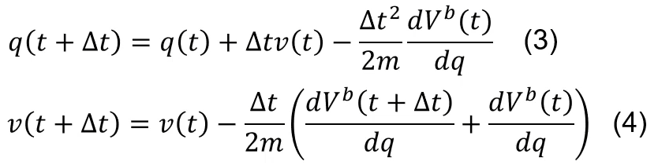
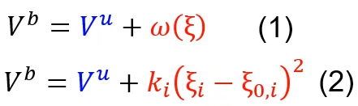
The Umbrella Sampling
Apply a bias potential
1st window
How does the force constant affect the simulation?

Slide 10
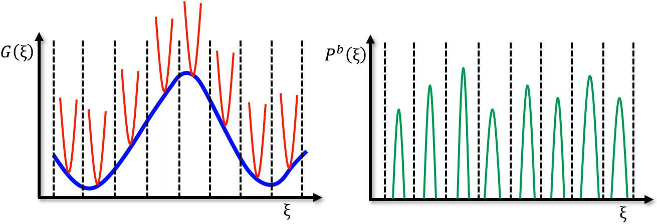
The Umbrella Sampling
Small k_{i} will not drive the system to overcome the energy barrier → V^{b} ≈ V^{u}
Large k_{i} will over-restrict the system therefore giving very narrow distributions.
Lacking overlap of distributions will result in awful energy profiles.
In this case, the amount of windows must be increased.

Slide 11
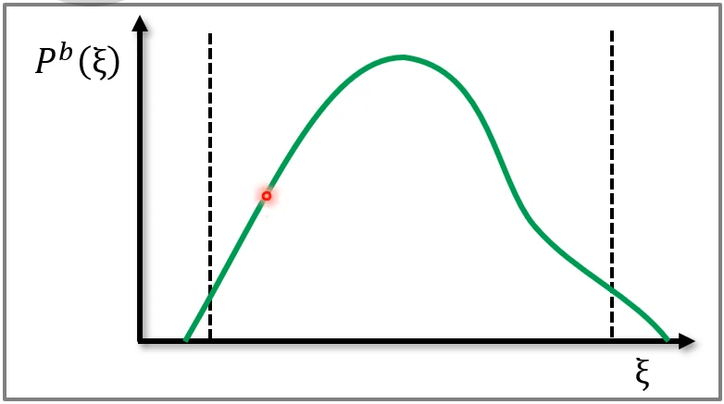
The Umbrella Sampling
1st window
Each window is then converted to probability distributions along the reaction coordinate.
The distribution corresponds to the MD for each window, so the distribution does not follow the real potential function.

Slide 12
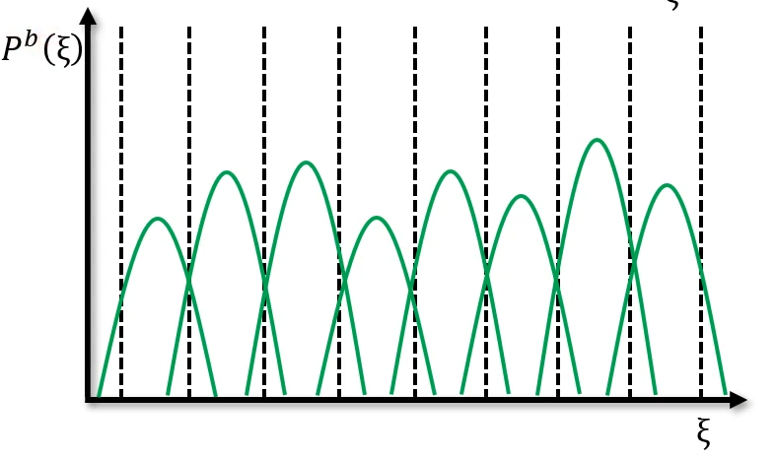
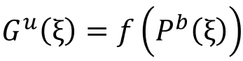
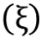
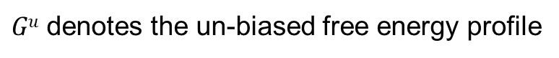
The Umbrella Sampling
For all the distributions for each windows along the reaction coordinate.
We then get the biased probability distribution.
But how do we convert the biased probability distribution to the un-biased free energy?
$Gu$ denotes the un-biased free energy profile
$Pb$ denotes the biased probability distribution
A well planned window selection with the suitable amount of windows and force constant

Slide 13

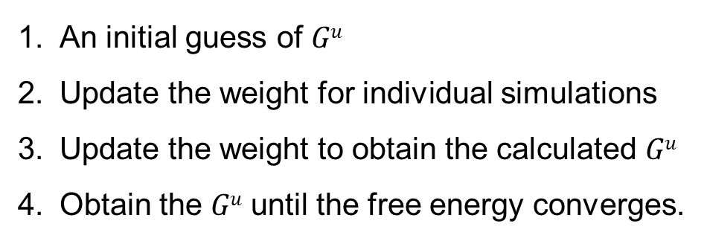
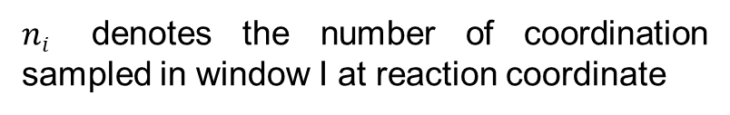
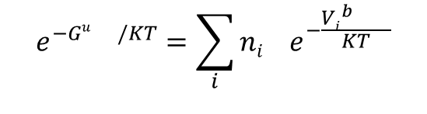
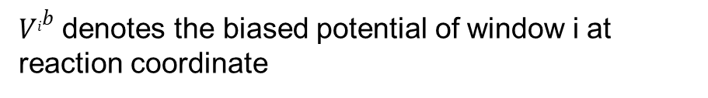
The Umbrella Sampling
Weighted histogram analysis method (WHAM)
$Gu$ denotes the un-biased free energy profile
$$e^{−Gu /KT}=\sum_{i}{ni{ e}^{−\frac{{Vi}^{b} }{KT}}}$$
$V^{ib}$ denotes the biased potential of window i at reaction coordinate
$ni$ denotes the number of coordination sampled in window I at reaction coordinate
Steps in WHAM analysis
An initial guess of $Gu$
Update the weight for individual simulations
Update the weight to obtain the calculated $Gu$
Obtain the $Gu$ until the free energy converges.

Slide 14
Interactive
Activate gromacs software
gmx editconf -f md_0_10.gro -o md_0_10-box.gro -c -box 20.000 20.000 10.000 -center 5.000 15.000 5.000
gmx solvate -cp md_0_10-box.gro -cs spc216.gro -p topol.top -o md_0_10-box-solvate.gro
gmx grompp -f ions.mdp -c md_0_10-box-solvate.gro -p topol.top -o ions.tpr
gmx genion -s ions.tpr -o md_0_10-box-solvate-ion.gro -p topol.top -pname NA -nname CL -neutral
gmx grompp -f minim.mdp -c md_0_10-box-solvate-ion.gro -p topol.top -o em.tpr
gmx mdrun -v -deffnm em -ntomp 4 -ntmpi 1 -gpu_id 0
15

Slide 15
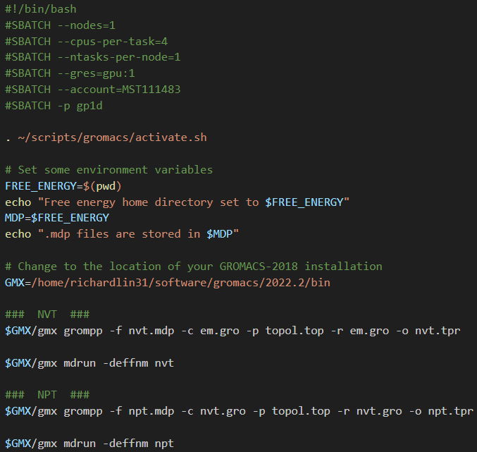
Interactive
sbatch job.sh
Submit for NVT and NPT

Slide 16
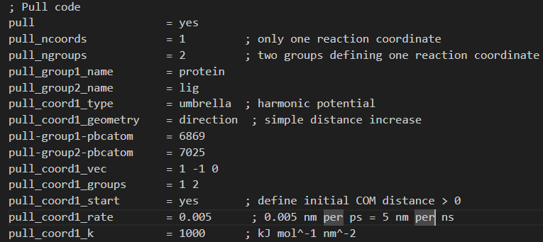
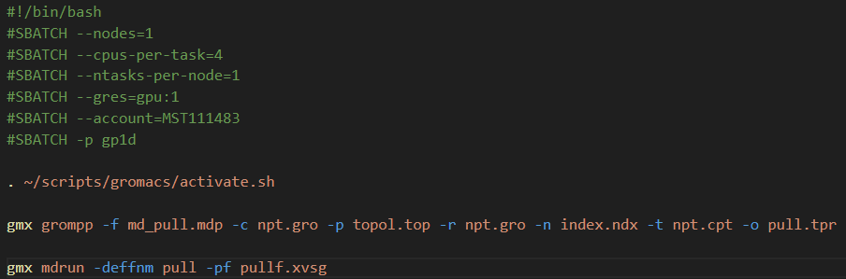
Interactive
Dig into md_pull.mdp
sbatch pull.sub

Slide 17
Enhanced sampling
There are multiple ways we can accelerate the sampling of these rare events:
Umbrella sampling (the MD equivalent of relaxed surface scan)
Requires user’s knowledge about reaction direction.
Requires trials on the magnitude of the pull force.
It is very difficult to sample the whole PES with US.

Slide 18
Enhanced sampling
There are multiple ways we can accelerate the sampling of these rare events:
Umbrella sampling (the MD equivalent of relaxed surface scan)
Replica exchange molecular dynamics

Slide 19
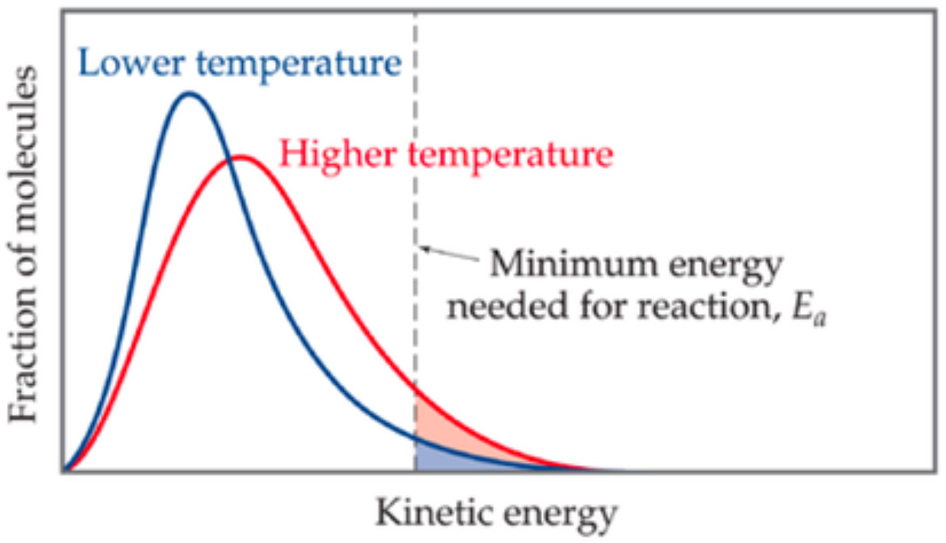
REMD
Lets say we want to investigate a process with very high energy barrier by MD. To overcome the energy barrier, we can populate the state B and the pathway that connects states A and B. Increasing the temperature allows the system to be un-trapped at a certain local minimum.

Slide 20
REMD
Lets say we want to investigate a process with very high energy barrier by MD. To overcome the energy barrier, we can populate the state B and the pathway that connects states A and B. Increasing the temperature allows the system to be un-trapped at a certain local minimum.
High temperatures
Low temperatures
Local minimums

Slide 21
REMD
Several replicas of the system are simulated at different temperatures. A pair of replicas with adjacent temperatures were exchanged after a round of MD. And as a result, the high-temperature (energy) configurations are processed at a low-temperature simulation in the end.
T₄
Replica 4
Replica 3
Replica 3
Replica 1
T₃
Replica 3
Replica 4
Replica 1
Replica 3
T₂
Replica 2
Replica 1
Replica 4
Replica 2
T₁
Replica 1
Replica 2
Replica 2
Replica 4

Slide 22
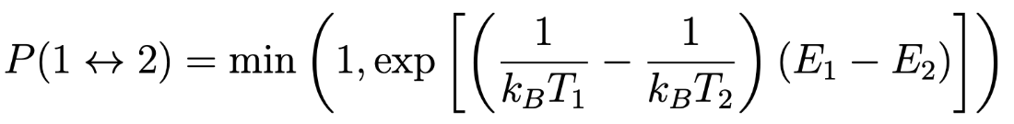
REMD
But keep in mind, the exchange of replicas may be rejected, that is where either there are a very high energy difference, low temperature difference, or the conformation mismatches for two replicas. The metropolis exchange criteria gives the acceptance probability to further determine whether the two replicas exchange or not.
A random number r between 0 and 1, is generated. If r ≤ P(1↔2), then the exchange is accepted.

Slide 23
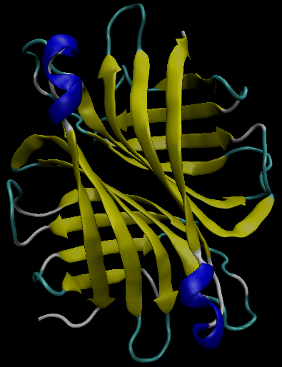
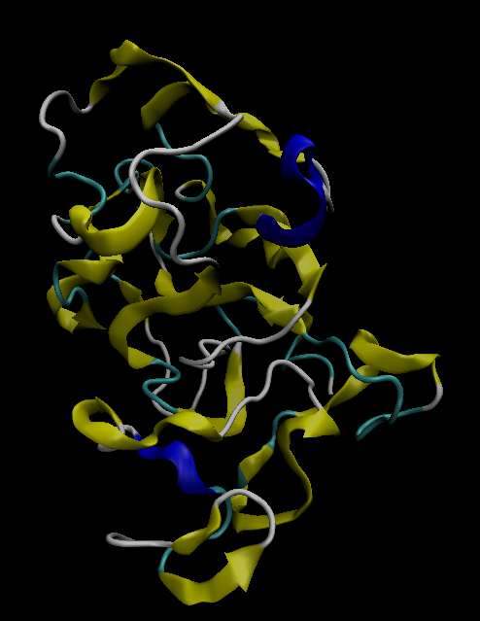
REMD
Because REMD are simulations mainly about the temperature. Proteins at high temperatures may result in denatured forms, therefore controlling the temperature of the systems (the maximum temperature) may be a difficult task and requires large amount of simulations. As for an example, the protein 1mk5 (streptavidin), it just denatures.
Original:
Denatured:

Slide 24
Interactive
Go to Exercise2
Copy the files needed from Week 10, Exercise 2: cp topol*, posre*, ind*, lig*, md_0_10.gro, charmm36-jul2021.ff/ to current working directory.
Activate gromacs software.
Activate generator.sh and give 5 arguments:
Look into the wrapper.sh scripts.
Look into the MD parameter .mdp files.
Submit all the wrapper.sh scripts created.
We are running TI from the system simulated last week
Activate the generator script to generate submission script
. generator.sh md_0_10.gro 4 300 600 equal
Argument 5: Spacing method
Argument 1: configuration file
Argument 2: number of replicas
Argument 4: Highest temperature
Argument 3: Lowest temperature

Slide 25
Enhanced sampling
There are multiple ways we can accelerate the sampling of these rare events:
Umbrella sampling (the MD equivalent of relaxed surface scan)
Replica exchange molecular dynamics
Temperature range hard to determine
No directionality. The system follows Boltzmann distribution of energy in its degrees of freedom

Slide 26
Enhanced sampling
There are multiple ways we can accelerate the sampling of these rare events:
Umbrella sampling (the MD equivalent of relaxed surface scan)
Replica exchange molecular dynamics
Metadynamics

Slide 27
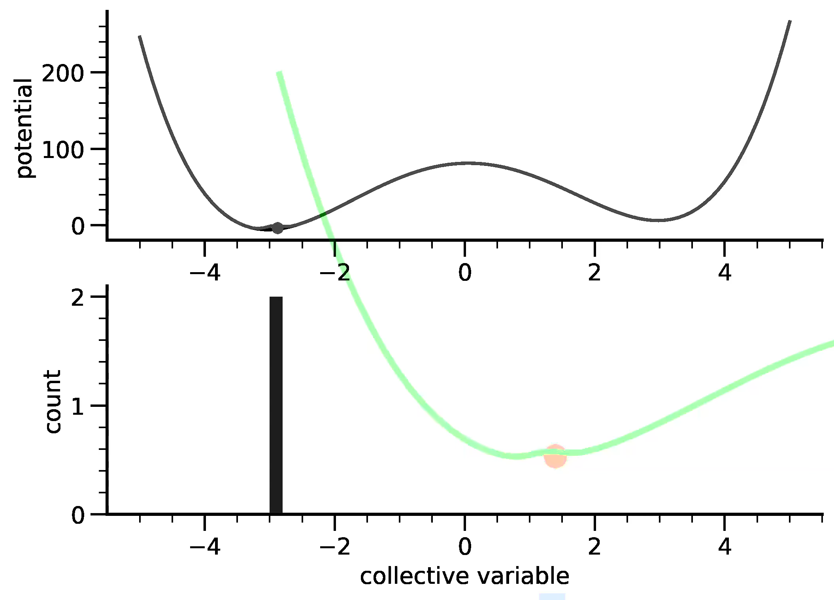
Metadynamics
Metadynamics simulation is another way to overcome the high energy barrier of a biological system. The concept of metadynamics is to apply a bias potential onto the energy surface of the system.

Slide 28
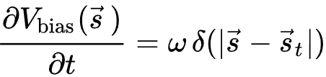
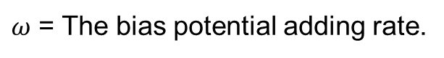
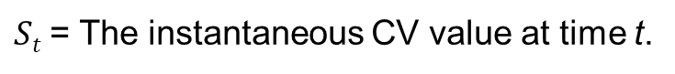
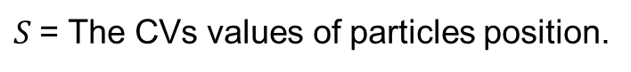
Metadynamics
The bias potential is a function of collected variables, collected variables are used to describe the essential features or order parameters of a system. The common CVs of a biological system are system based.
At infinitely long simulations t_{sim}, accumulated bias potential converges to free energy with opposite sign
$ω$ = The bias potential adding rate.
$S$= The CVs values of particles position.
$St$= The instantaneous CV value at time t.

Slide 29
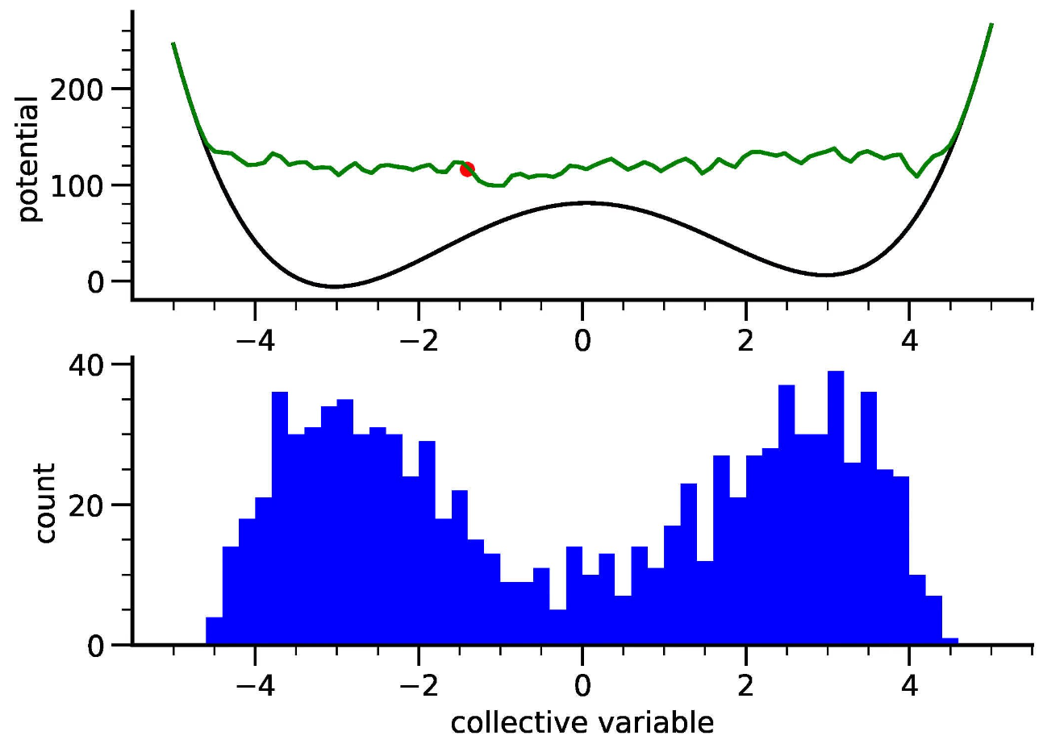
Metadynamics
As the simulation progresses, the accumulated bias potential alters the original energy landscape of the system, lowering the free energy barriers and allowing the system to sample regions that were previously energetically unfavorable.
The count refers to the number of Gaussian potentials that have been deposited during the simulation, and can used for assessing the convergence of the simulation

Slide 30
Interactive
We will not run any exercises on metadynamics. Instead, we will visualize the results from the pulling step of our umbrella sampling.
Visualize the pulling system

Slide 31
Enhanced sampling
There are multiple ways we can accelerate the sampling of these rare events:
Umbrella sampling (the MD equivalent of relaxed surface scan)
Replica exchange molecular dynamics
Metadynamics

Slide 32
Enhanced sampling
There are multiple ways we can accelerate the sampling of these rare events:
Umbrella sampling (the MD equivalent of relaxed surface scan)
Replica exchange molecular dynamics
Metadynamics
Thermodynamic integration

Slide 33
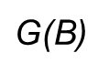
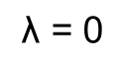
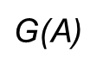
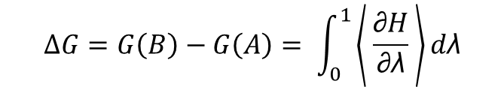
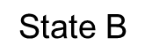
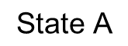
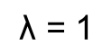
Thermodynamic Integration
Sometimes, we just want the binding free energy but the trouble of sampling the unbound state. In TI simulations, the system is gradually "morphed" from one state to another, during which the effect of this perturbation onto the free energy is monitored. The "morph" is defined by a parameter lambda, which is defined to be zero in the initial state (A), and one in the final state (B). By collecting the derivative of the potential energy with respect to lambda during the simulation, and by integrating over lambda afterwards, we gain access to the free energy.
$$\text{λ}\text{ = 0}$$
$$\text{λ}\text{ = }\text{1}$$
$$\text{S}\text{tate} \text{A}$$
$$∆G=G\left(B\right)−G\left(A\right)= \int_{0}^{1}{\left\langle \frac{\text{∂}H}{\text{∂}\text{λ}} \right\rangle d\text{λ}}$$
$$\text{S}\text{tate} \text{B}$$
$\text{G}\text{(}\text{A}$)
$\text{G}\text{(}\text{B}$)

Slide 34
Thermodynamic Integration
Common lambda (λ) parameters to modify
Coul_lambdas
Vdw_lambdas
Bonded_lambdas
Restraint_lambdas
Mass_lambdas
Temperature_lambdas
Fep_lambdas

Slide 35
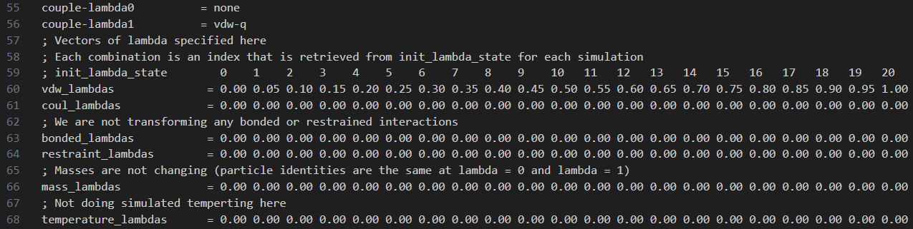
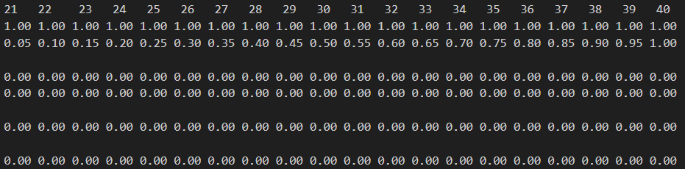
Thermodynamic Integration
Mdp file for modification of lambdas

Slide 36
Interactive
Go to Week11/Exercise1
Copy the files needed from Week 10, Exercise 2: cp topol*, posre*, ind*, lig*, md_0_10.gro, charmm36-jul2021.ff/ to current working directory.
Activate gromacs software.
Activate generator_parallel.sh and give 1 argument:
Look into the wrapper.sh scripts.
Look into the MD parameter .mdp files.
gmx bar -f */*/xvg
We are running TI from the system simulated last week
Activate the generator script to generate submission script
. generator_parallel.sh md_0_10.gro
Argument 1: configuration file

Slide 37
Interactive
Use the VMD software to observe the configurations generated.

Slide 38
Interactive
The experimental value of binding free energy for Streptavidin-biotin system is -18 kcal/mol. For our previous 10 ns MD TI calculation, the calculated value is -18.60 ± 0.57 kcal/mol. As for calculation value from Exercise 2, it is XXXX ….

